Slide 1
Image to sketch converter
Using python

Slide 2
introduction
In Python, an image is just a two-dimensional array of integers. So one can do a couple of matrix manipulations using various python modules in order to get some very interesting effects. In order to convert the normal image to a sketch, we will change its original values and assign its values similar to grey, in this way a sketch of the input image will be generated.

Slide 3
IMPORTANCE OF IMAGE TO SKETCH CONVERTER
Create beautiful realistic pencil sketches with the package sketchify in Python.
Creating a realistic pencil sketch by hand requires hours of agonizing work: from converting textures, perfecting shadows, to the tiniest of details. Now, we can create realistic pencil sketches in Python

Slide 4
Code
from tkinter import *
import tkinter.filedialog as tk
import tkinter.messagebox as tk2
import numpy as np
import cv2
class Application(Frame):
def __init__(self, master):
super(Application, self).__init__(master)
self.img = ""
self.grid(rowspan=5, columnspan=4)
self.addButton = Button(self, text='Add', command=self.add)
self.generateButton = Button(self, text='Generate', command=self.generate)
self.generateButton.grid(row=4, column=0)
self.addButton.grid(row=4, column=2)
self.pack() def add(self):
file = tk.askopenfilenames(initialdir='C:/Users/babbu/Downloads')
imgTuple = root.splitlist(file) # turn user's opened filenames into tuple
self.img = "".join(list(imgTuple))
def generate(self):
img_obj = cv2.imread(self.img)
# img_obj.shape -- to check the shape of image
scale_percent = 0.60
width = int(img_obj.shape[1] * scale_percent)
height = int(img_obj.shape[0] * scale_percent)

Slide 5
dim = (width, height)
resized = cv2.resize(img_obj, dim, interpolation=cv2.INTER_AREA) # resizing the image
kernel_sharpening = np.array([[-1, -1, -1],
[-1, 9, -1],
[-1, -1, -1]])
sharpened = cv2.filter2D(resized, -1, kernel_sharpening) # shape the image
gray = cv2.cvtColor(sharpened, cv2.COLOR_BGR2GRAY) # convert in black and white
object_detection = cv2.cvtColor(sharpened, cv2.COLOR_BGR2HSV) # convert in image detection formate
inv = 255 - gray # convert in inverse form
gauss = cv2.GaussianBlur(inv, ksize=(15, 15), sigmaX=0, sigmaY=0) # convert in gauss form
pencil = cv2.divide(gray, 255 - gauss, scale=256)
# to displa # cv2.imshow("gray", gray)
cv2.imshow('pencile', pencil)
cv2.waitKey(0)
cv2.destroyAllWindows()
y these four images
cv2.imshow('resized', resized)
# cv2.imshow('sharp',sharpened)
root = Tk()
root.title('Sketch-Maker')
root.geometry('500x200')
app = Application(root)
app.mainloop()

Slide 6
steps
Import all required modules (numpy, tkinter,OpenCV)
Open the message box and add Image as input
Then check the shape of image
Convert image in black and white format.
Convert in image detection format.
Convert in inverse form.
Convert in gaussian form.
Convert in gray format.
Display sketch

Slide 7
package
Import opencv-python:
OpenCV is the huge open-source library for computer vision, machine learning, and image processing. By using it, one can process images and videos to identify objects, faces, or even the handwriting of a human.
To Identify image patterns and its various features we use vector space and perform mathematical operations on these features.

Slide 8
Tkinter:
Tkinter provides various controls, such as buttons, labels and text boxes used in a GUI application. These controls are commonly called widgets.
Tkinter is the standard GUI library for Python. Python when combined with Tkinter provides a fast and easy way to create GUI applications. Tkinter provides a powerful object-oriented interface to the Tk GUI toolki

Slide 9
Numpy
NumPy is a Python library used for working with arrays.
It also has functions for working in domain of linear algebra, fourier transform, and matrices.
NumPy stands for Numerical Python.

Slide 10
functions
When import cv2 inside our code, after that, we will use some of the following functions:
imread()- This function will load the image i.e in the specified folder.
cvtColor()- This function takes color as an argument and then changes the source image color into that color.
Greyscale()-We then make the image black and white.
bitwise_not()- This function will help the image to keep the properties as same by providing the masking to it.

Slide 11
GaussianBlur()- This function is used to modify the image by sharpening the edges of the image, smoothen the image, and will minimize the blurring property.

Slide 12
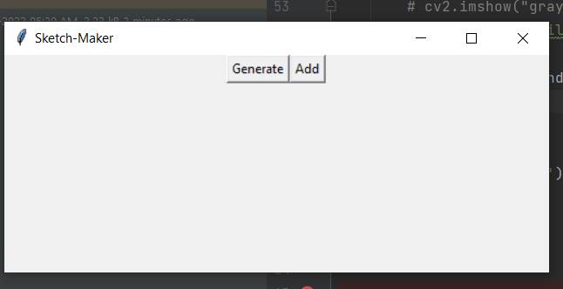
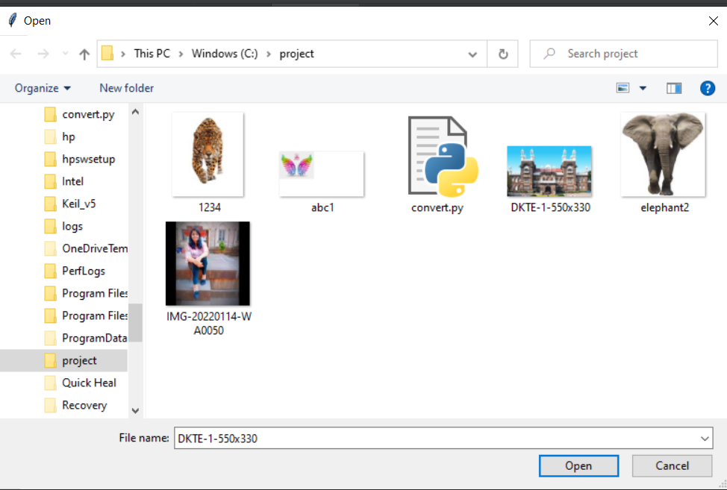
output

Slide 13
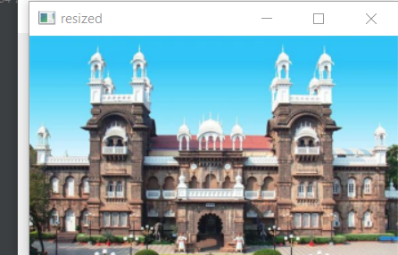
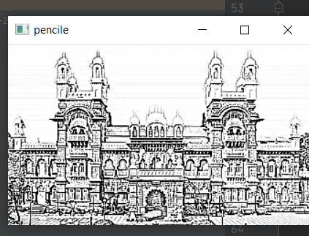

Slide 14
By
ANKITA ASHOK HULLE (20UET302)
SANIKA NITIN KADAM (20UET304)
PRAJAKTA NEMINATH PATIL(20UET307)

Slide 15
THANK YOU……

